Slide 1

Introduction to Machine Learning
MSCI 446
Empirical Evaluation Project
Winter 2024
Group 33
Kelly Singh
Daniel Pérez Fernández
Daniel Sánchez de la Cruz
Jackson Xiao
József Iván Gafo
Notes:
Daniel S.

Slide 2
Goal and Problem
For this project, we are planning on doing an empirical evaluation. The area of interest for our project is to propose a Machine Learning algorithm that will predict the house prices in the Ontario Region for the year 2024.
The ability to predict future housing prices is important to the government, financial institutions, homeowners and homebuyers, and the general economy. The government may use the predictions as a factor that influences the interest rate set forth by the Bank of Canada. This interest rate is used as the benchmark that banks, lenders, and other financial institutions use to set interest rates for loans, mortgages, and all other lending products. Homeowners and homebuyers can use this data to predict the best times to sell/buy property.
With houses representing such a large portion of an individual/family’s financial assets (especially at younger ages), this data could determine their confidence to spend for upcoming years and gain an understanding of their financial security. Corporations such as investment banks could use these predictions to understand economic trends. Housing prices are typically tied to the economy, and investment banks may take this data into consideration when deciding on their investment strategies for the upcoming years.
Notes:
Daniel S.

Slide 3

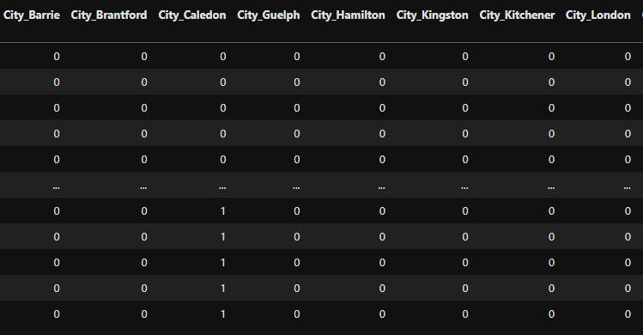
Datasets
The raw dataset was obtained from Kaggle. It contains data across Canada that could be relevant to housing prices such as number of bedrooms, number of bathrooms, city and other information such as longitude, latitude, province, address, median family income, and population (of the city).
We took this raw dataset and cleaned it by removing certain rows and modifying the location feature to only contain data for cities in Ontario. To properly utilize location as a feature for our models, we used one-hot encoding and created dummy variables.
…
Notes:
Jackson

Slide 4
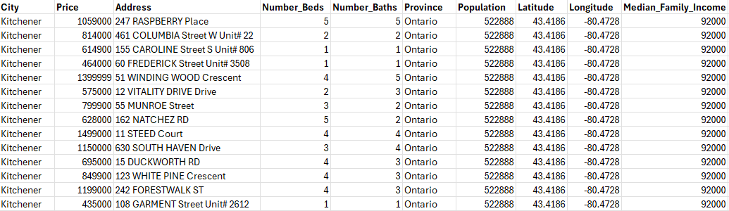
Raw Dataset
Column Names
City string
Price number
Address string
Number_Beds number
Column Names
Number_Baths number
Province string
Population number
Latitude number
Column Names
Longitude number
Median_ number
Family_Income
Number of Rows
34,588
Sample Rows
Source (link)
https://www.kaggle.com/datasets/jeremylarcher/canadian-house-prices-for-top-cities
Notes:
jackson

Slide 5
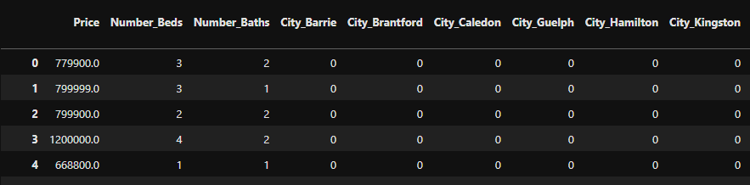
Cleaned Dataset
Column Names
Price number
Number_Beds number
Number_Baths number
Column Names
Dummy variables number
Created with one-hot encoding for the following cities
Barrie, Brantford, Caledon, Guelph, Hamilton,
Kingston, Kitchener, London, Oshawa, Ottawa,
Peterborough, Sault Ste. Marie, St. Catharines,
Sudbury, Thunder Bay, Toronto, Windsor
Number of Rows
14,001
Sample Rows
Source (link)
https://www.kaggle.com/datasets/jeremylarcher/canadian-house-prices-for-top-cities
…
Notes:
Dani 1

Slide 6
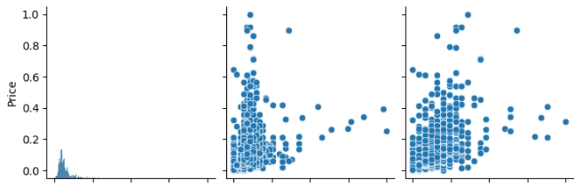
Machine Learning Model
Features
Number_Beds number
Number_Baths number
City one-hot encoding
Class Label
Price number
Linear regression vs Polynomial Regression
It seems that there is a general positive trend indicating that more beds and baths may lead to higher prices, but the relationships do not seem to be strictly linear—a slight curve might help.
Therefore, we will try to fit both a linear regression model and a polynomial regression model with degree 2 and see which returns better predictions (i.e. less error).
Notes:
Kelly Describe the machine learning that you used: what are the features, what is the class label, etc. Justify why your datasets are appropriate for training a model to solve your problem - The class label in our dataset is the house price. This is the value we aim to predict based on the features mentioned above.
Linear regression is a fundamental statistical method used to model the relationship between a dependent variable and one or more independent variables.
The model assumes a linear relationship between these variables, aiming to find the best-fitting straight line that minimizes the difference between the observed and predicted values.
Polynomial regression is an extension of linear regression, allowing for more complex relationships between variables. Instead of fitting a straight line, polynomial regression fits a curve to the data by introducing polynomial terms of the independent variables. In our case, we used a polynomial of degree 2, which means our model considers not only the linear effects but also the squared terms of the predictors.
In our project, we applied both linear and polynomial regression techniques to predict house prices in Ontario based on historical data. By comparing the performance metrics such as Mean Absolute Error (MAE) and Mean Squared Error (MSE) on training and test sets, we can assess the effectiveness of these models in capturing the underlying patterns and making accurate predictions.

Slide 7
Cross-Validation and Bootstrapping
Cross-validation
To evaluate the performance of our model, we will use a K-fold Cross-Validation technique with 10 folds to measure if our model generalizes well on untrained data.
Additionally, we will conduct a Leave-One-Out Cross-Validation (LOOCV) technique, a more computationally intensive approach that trains the model N times for a dataset with N instances.
Bootstrapping
We will use bootstrapping to estimate the model’s test error by resampling with replacement and calculating the Mean Squared Error (MSE) for each bootstrap sample. We will derive 1000 bootstrap samples from the original sample, with a 70:30 train/test dataset proportions.
From these calculations, we will calculate a 95% confidence interval that will inform us of the consistency of our model’s performance, offering insights into its reliability with unseen data.
Notes:
József

Slide 8
Linear Regression: Results and Evaluation
Mean errors
Train MAE: 0.02218303474654621
Train MSE: 0.0018345580183146356
Test MAE: 0.02181501193589162
Test MSE: 0.0015736732357044517
Leave-One-Out-Cross-Validation MSE: 0.0017879175213583605
Evaluation of the results
Both the training and test MAE and MSE have similar values. This suggests that the model is neither overfitting nor underfitting, and generalizes well to unseen data.
As the variables were scaled using a MinMaxScaler, this means that, on average, the model's predictions are off by only around 2.2% of the total scaled house price range, suggesting a potentially strong model.
The small MSE of the cross-validation indicates a well performing model.
Notes:
Kelly mean absolute error and mean squared error are common metric used to evaluate tyhe performance of a regression model.
mae - average absolute difference betweent he actual and predicted values
mse - average squared difference between the actual and predicted
the metrics provide insights into how well the linear regression model performs on both training and test datasets.
lower values of mae and mse indicate better predictive performance with the test metrics reflecting the model's ability to generalize to unseen data.

Slide 9
Bootstrapping (Linear Regression): Results and Evaluation
Mean error
We used a bootstrapping resampling method with 1000 iterations and 70% of the original dataset size. Then we calculated the different MSE and created a 95% confidence interval, obtaining the following range:
[0.15698, 0.15890]
Evaluation of the results
This interval indicates that the MSE of the model on unseen data will fall within this range, meaning that the model’s predictions will be off by approximately 15.7% - 15.9% of the scaled target house price, on average.
This error is quite substantial compared to the previously obtained results, revealing that improvements can always be made to obtain a better performing model. Nonetheless, our model has already revealed to have good predicting capabilities when using other methods of evaluation, like Leave-One-Out cross validation.
Notes:
József

Slide 10
Polynomial Features Regression: Results and Evaluation
Mean errors
Train MAE: 0.020848664665763
Train MSE: 0.001621607421188509
Test MAE: 0.021037588927001017
Test MSE: 0.0015678909147056905
Evaluation of the results
Again, both the training and test MAE and MSE have similar values, suggesting that the model is neither overfitting nor underfitting.
On average, the model's predictions are off by only around 2% of the total scaled house price range, obtaining an improvement of 0.2% over the linear regression model.
Notes:
Dani 1

Slide 11
Bibliography
House Sales in Ontario
Canadian house prices for top cities
Housing Affordability in Canada
House Sales in Ontario - Data Analysis

